Slide 1
Lead quality prediction
Development of a Classification model with Machine Learning

Slide 2
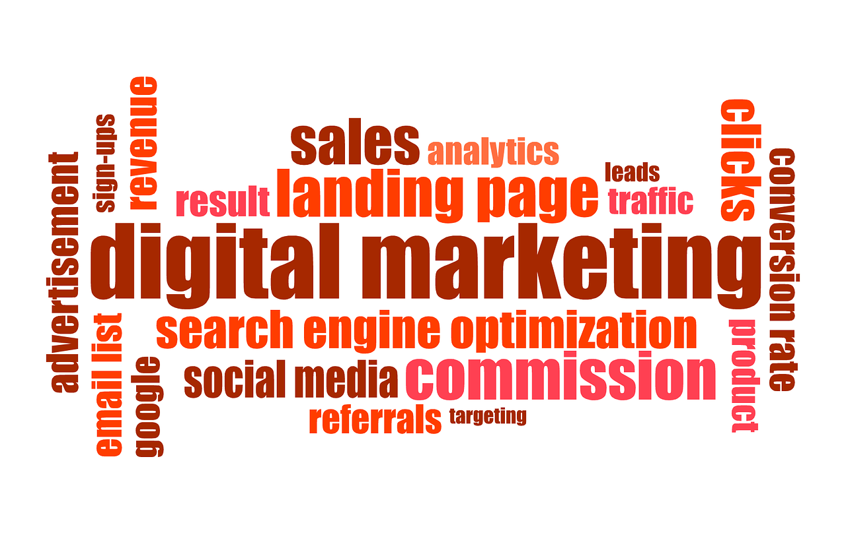
Índex
01 Introduction
02 Basis for the project
03 Goals
04 State-of-art and Methodology
05 Results
06 Conclusions

Slide 3

01 Introduction
“Lead” is a concept applied in marketing & sales.
A lead is a potential customer with an interest in what you are selling (either a product or a service).
Leads are generated when a potential customer fills up an online form on the website, calls requesting info, initiates a chat on the website, interacts with the company on social media…
Typically leads are captured with a CRM software (Customer Relationship Management).

Slide 4
02 Basis for the project
Obtaining the maximum possible number of leads from potential clients (and subsequently registering them in the CRM) is a powerful way to increase the sales or launch new products.
But the large amount of accumulated information, if it is not worked properly, can generate a dispersion of resources and unfocus the organization.
Thus, it is needed to develop tools to solve the “costly conflict”:

Slide 5
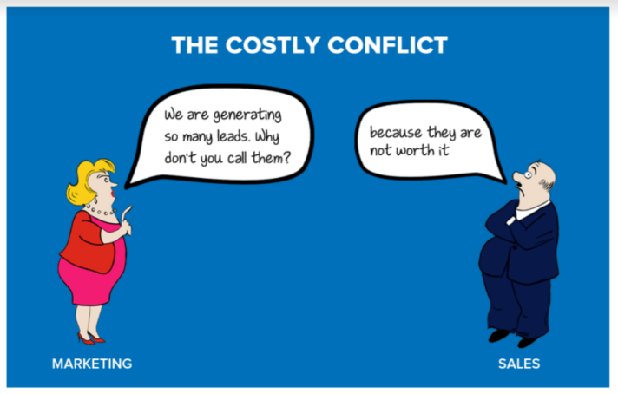

Slide 6

03 Goals
The dataset analyzed contains a lot of unstructured information about the leads obtained by an educational institution in India, which offers online training courses.
The goals are:
build an accurate prediction model to identify the conversion of a lead in an actual customer.
analyze which trends and behavior patterns favor conversion

Slide 7

04 State-of-Art and Methodology (I)
The dataset contains 9240 instances with 37 variables and one output target (0/1). There are 6 numerical variables and 31 categorical variables (either nominal, ordinal or boolean).
Qualitatively, the variables can be split into two groups:
data about the potential customer that generated the lead, such as country, city, occupation, score given by the commercial team…
data about the interaction with the potential customer: total on-line visits, total time spent on website…
It’s a balanced dataset, the target has 38,5% of positives and 61,5% of negatives.
3 authors have analyzed the same dataset and developed a predictive model, they all have selected Logistic Regression as a model, reaching a range of accuracies between 0.80 and 0.92.

Slide 8

04 State-of-Art and Methodology (II)
The main metric selected is accuracy because we want to predict the conversion result of the lead (yes/no) with the greatest success.
The general strategy has been to replace nulls in categorical variables with the category "unknown".
To identify patterns that favor conversion we select categories with > 500 leads and conversion > 50%. For the numeric variables, the value ranges where the lead conversion is > 50%.
Feature engineering with Robust Scaler (many and far outliers) and dummies. Dataset divided into Train (70%) and Test (30%).
7 classification algorithms tested. Cross Validation applied to check overfitting. Hyperparameters adjusted.
Finally we select Random Forest Classifier. Feature importances presented.

Slide 9

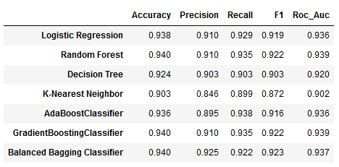
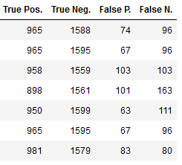
05 Results (I)
Metrics:
Random Forest & Gradient Boosting Classifier were preselected

Slide 10


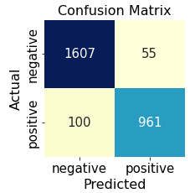
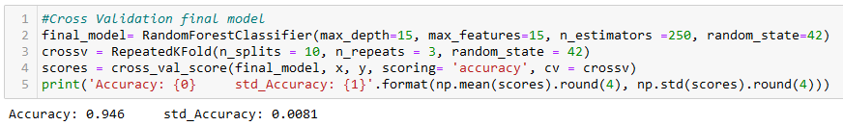
05 Results (II)
Metrics after hyperparameters adjusted:
Cross Validation:

Slide 11

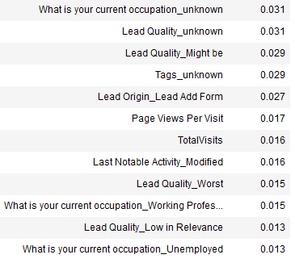
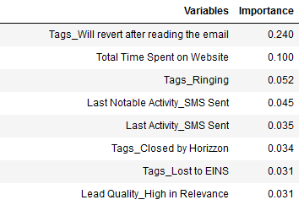
05 Results(III)
Feature importance:

Slide 12

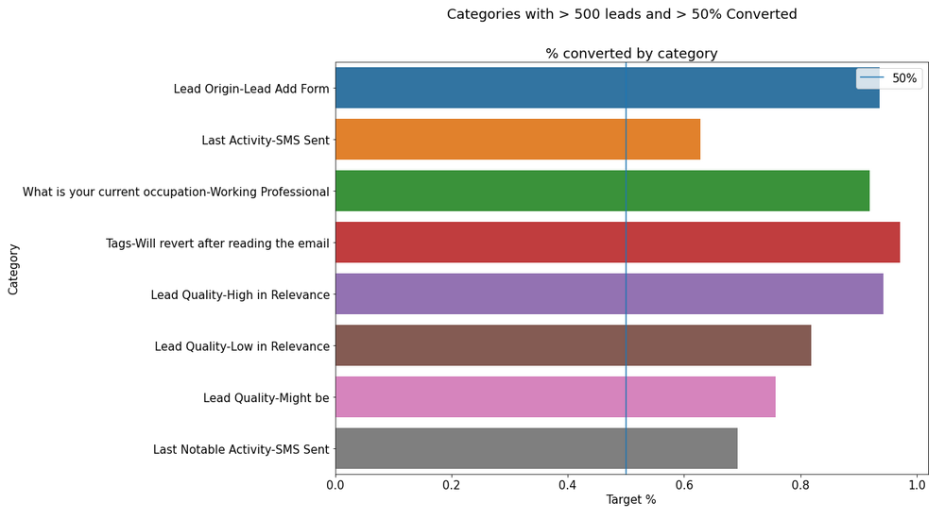
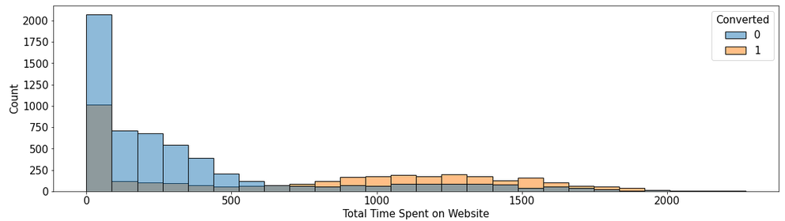
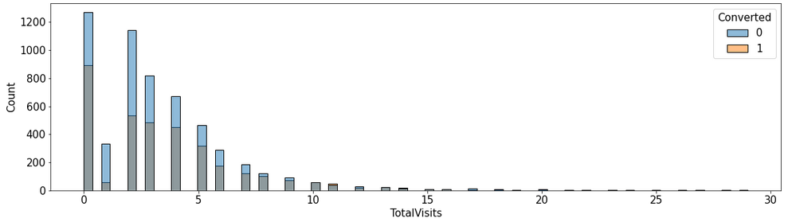
05 Results (IV)
Trends and behavior patterns that favor conversion:

Slide 13

06 Conclusions
In this project we have developed a model to predict lead conversion in the specific case of marketing of online courses.
Machine Learning tools proven to be effective to solve the “costly conflict”.
Data preparation is the key to achieve the best metric results. Remove the irrelevant, keep the relevant even if it is incomplete.
The model achieved a prediction of the result of the lead with an accuracy greater than 0.94. This allows:
to optimize resources and maximize sales
to establish robust sales predictions for online courses
Through an analysis of the data, we were able to segment the potential customers based on the probability of their conversion into clients.
This will allow to establish strong guidelines to focus the marketing action.

